Slide 1
Christchurch central rebuild Plan
ITC601 - Project Management
Kauê Reis de Assis Pereira

Slide 2
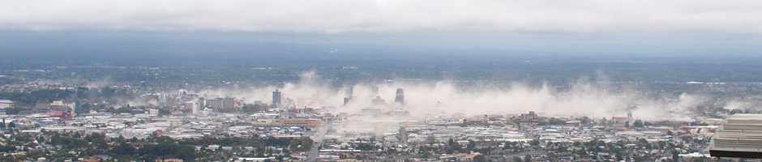
The problem
September 4th, 2010
magnitude 7.1 earthquake at 40 km west of Christchurch
February 22nd, 2011
magnitude 6.3 earthquake at 10 km southeast of Christchurch

Slide 3
The Project
Government of New Zealand establishes the Canterbury Earthquake Recovery Authority (CERA)
CERA issues the Christchurch Central Recovery Plan with the main goal of rebuilding Christchurch Central City
Land Use Recovery Plan is created with the main objective of rebuilding Greater Christchurch

Slide 4
Goals
Rebuild Christchurch Central City
Green city
Compact core
Accessible city
Strong identity
Place to live, work, play, learn and visit
Embrace cultural values

Slide 5
Challenges
Too much space
Not enough demand of retail to occupy the central city
Time
Project was urgent, but too wide and complex
Severe and widespread damage
Rebuild of large areas was required
Attract investment
Need of support and investment of private sector
Multiple owners
Central city had multiple land owners, and project required coordinated design and collaboration
East was more damaged than west
As a result, individual redevelopments may seem isolated until the overall progress

Slide 6
Design Principles
Focus on the areas that need the most assistance to redevelop.
COMPRESS
Compress the size and scale of expected development to generate a critical mass in the Core.
CONTAIN
Contain the Core to the south, east and north with a frame.
CATALYSE
Position anchor projects so that development opportunities are created around and between them.
Locate anchor projects where the existing amenity features support their success.
SUPPORT
REPAIR
Invite and attract people into the central area as a place to live, work, play, learn, visit and invest.
EMBRACE THE RIVER
Respond to the river corridor as the highest-value amenity space.
OPEN SPACE
Create new open spaces and improve existing open spaces.
COMPLETE
Complete the Core as quickly as possible.
Re-use existing buildings and building elements to provide continuity and reference points to the city’s past.
EXISTING VALUE
ATTRACT

Slide 7
Stakeholders
New Zealand Government
Canterbury Earthquake Recovery Authority
Christchurch City Council
Te Rūnanga o Ngāi Tahu

Slide 8
Stakeholders
Residents and Community
Business Community
Non-Governmental Organizations
Construction Companies and Workers

Slide 9
Anchor Projects
The Frame
Retail Precinct
Earthquake Memorial
Avon River Precinct
Health Precinct
Cricket Oval
Metro Sports Facility
Bus Interchange
Residential Demonstration
Stadium
The Square
Central Library
Innovation Precinct
Performing Arts Precinct
Convention Centre Precinct
Te Puna Ahurea Cultural Centre
Justice and Emergency Services Precinct

Slide 10
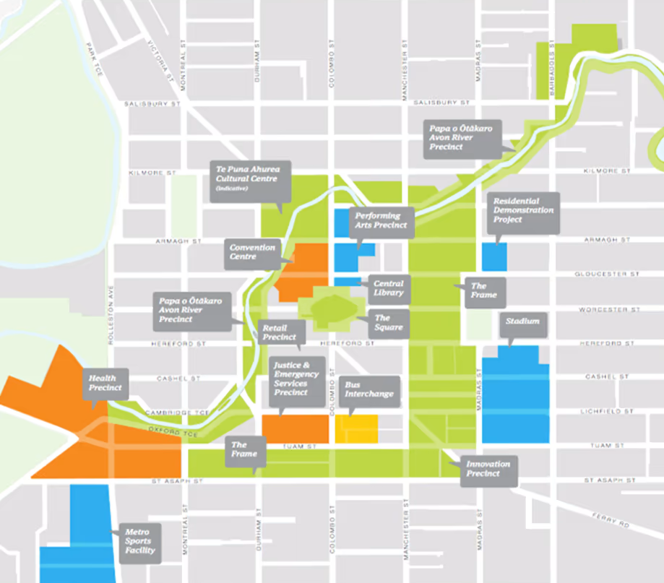

Slide 11
Milestones
Support, assist and provide information to communities and individuals.
Stronger Christchurch Infrastructure Rebuild Team (SCIRT) Alliance assesses damage and starts repairs to infrastructure.
Restore non-chlorinated water supply to residents and declare beaches safe for swimming.
Decide on suitability of land for rebuilding. Establish green and red residential zones.
Government makes offer to purchase residential red zone properties and settlements begin.
Begin to demolish dangerous buildings.
New Building Act Guidelines establish new standards for buildings.
Earthquake Commission (EQC) and insurance companies undertake damage assessments and payouts are underway.
Greater Christchurch residents engage with government and local government on the future of the central city and the nature and coordination of recovery activities (draft Recovery Plan for the CBD and draft Recovery Strategy).

Slide 12
Milestones
Facilitate the release of land for new subdivisions.
Approve Recovery Strategy to direct and coordinate recovery activities and agencies involved in recovery.
Restore access to and transportation networks in central city.
Establishment of the Christchurch Central Development Unit (CCDU).
Finalisation of the Recovery Plan for the CBD.
Rebuilding of the CBD starts.
Complete decisions on land zones and geotechnical issues.
Continue repair of infrastructure and make decisions about long-term repair and provision of infrastructure.
Finish demolition of larger commercial buildings.
Government and statutory partners undertake recovery programmes.

Slide 13
Milestones
Complete settlements and land clearance for residential red zone properties.
EQC and insurers undertake residential repairs and rebuilds.
Establish new residential subdivisions.
Find facilities for sporting and cultural activities.
Construct temporary buildings for entertainment and retail in greater Christchurch.
Government and strategic partners continue to implement recovery programmes.
Continue rebuilding and construction.
EQC and insurers complete residential repairs and rebuilds.
Major sporting and cultural facilities are under construction.
Recovery responsibilities are transferred when necessary. Put new arrangements in place.

Slide 14
Summary
The Christchurch Central Rebuild Plan aimed to not only recover the Christchurch Central City from the damages caused by the earthquakes but also leverage the need for rebuilding as an opportunity to enhance what it was before the disaster. It presented 17 anchor projects that were supposed to bring life into the heart of Christchurch and attract people back to the local community, and the local community back to the city centre.

Slide 15
References
Christchurch City Council. (2014). Christchurch Central Recovery Plan (Publication No. ISBN 978-0-478-38703-3). https://ccc.govt.nz/assets/Documents/The-Council/Plans-Strategies-Policies-Bylaws/Plans/central-city/christchurch-central-recovery-plan-march-2014.PDF
Greater Christchurch Group. (n.d.). Recovery Strategy for Greater Christchurch. https://greaterchristchurch.org.nz/assets/Documents/greaterchristchurch/recovery-strategy-for-greater-christchurch-Copy2.pdf
Department of the Prime Minister and Cabinet. (n.d.). Land Use Recovery Plan. https://www.dpmc.govt.nz/our-programmes/greater-christchurch-recovery-and-regeneration/recovery-and-regeneration-plans/land-use-recovery-plan

